Slide 1
Analysis of Algorithms
Input
Algorithm
Output
An algorithm is a step-by-step procedure for
solving a problem in a finite amount of time.

Slide 2
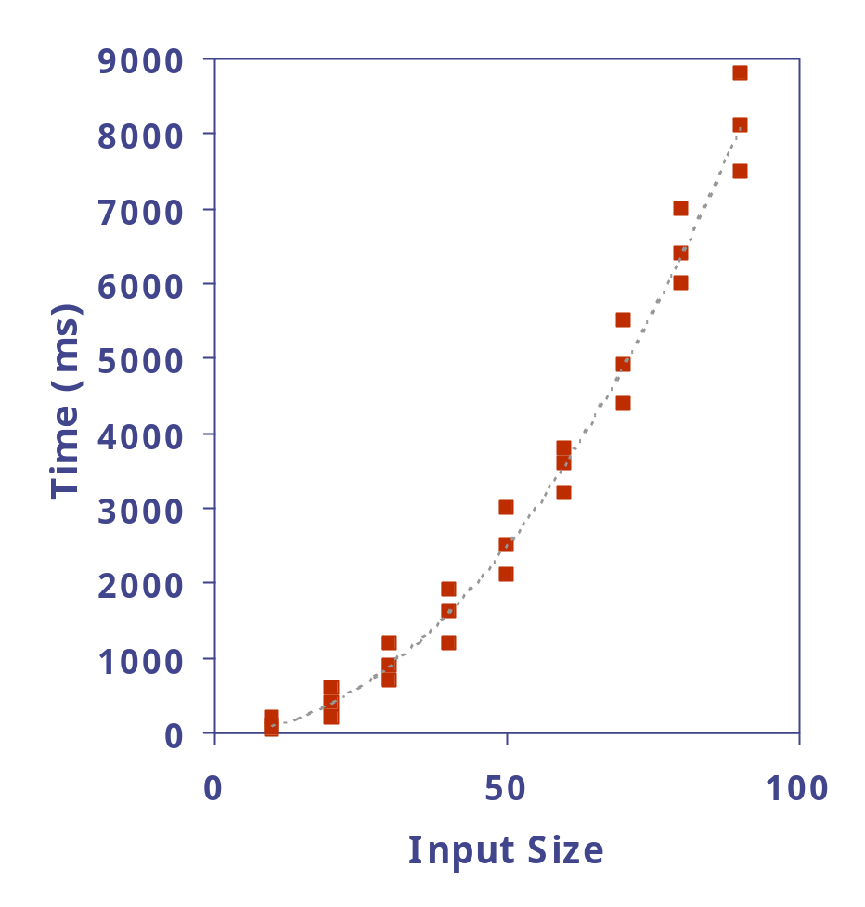
Experimental Studies
Write a program implementing the algorithm
Run the program with inputs of varying size and composition
Plot the results

Slide 3
Limitations of Experiments
It is necessary to implement the algorithm, which may be difficult
Results may not be indicative of the running time on other inputs not included in the experiment.
In order to compare two algorithms, the same hardware and software environments must be used

Slide 4
Theoretical Analysis
Uses a high-level description of the algorithm instead of an implementation
Characterizes running time as a function of the input size, n.
Takes into account all possible inputs
Allows us to evaluate the performane of an algorithm independent of the hardware/software environment

Slide 5
Primitive Operations
For theoretical analysis, we will count primitive or basic operations, which are simple computations performed by an algorithm.
Basic operations are:
Identifiable in pseudocode
Largely independent from the programming language
Exact definition not important

Slide 6
Pseudocode
Example: find max element of an array
High-level description of an algorithm
More structured than English prose
Less detailed than a program
Preferred notation for describing algorithms
Hides program design issues
Algorithm arrayMax(A, n)
Input array A of n integers
Output maximum element of A
currentMax ← A[0]
for i ← 1 to n − 1 do
if A[i] > currentMax then
currentMax ← A[i]
return currentMax

Slide 7
Primitive Operations
Examples of primitive operations:
Evaluating an expression x² + y²
Assigning a value to a variable cnt ← cnt+1
Indexing into an array A[5]
Calling a method mySort(A,n)
Returning from a method return(cnt)

Slide 8
Counting Primitive Operations
By inspecting the pseudocode, we can determine the maximum number of primitive operations executed by an algorithm, as a function of the input size
Algorithm arrayMax(A, n)
currentMax ←A[0] 1
for i ← 1 to n − 1 do n
if A[i] > currentMax then (n − 1)
currentMax ←A[i] (n − 1)
{ increment counter i } (n − 1)
return currentMax 1
Total 4n − 1

Slide 9
Estimating Running Time
Algorithm arrayMax executes 4n − 1 primitive
operations in the worst case. Define:
a = Time taken by the fastest primitive operation
b = Time taken by the slowest primitive operation
Let T(n) be worst-case time of arrayMax. Then a (4n − 1) ≤ T(n) ≤ b(4n − 1)
Hence, the running time T(n) is bounded by two linear functions

Slide 10
Example: Selection Sort
public static void selectionSort(Comparable[] a) { //array of size n
for (int i = 0; i < a.length; i++) { <-- cost = c1, n times
int MinPos = i; <-- cost = c2, n times
for (int j = i+1; j < a.length; j++) { <-- cost = c3, n*(n-1)/2 times
if (a[j].compareTo(a[MinPos]) < 0) <-- cost = c4, n*(n-1)/2 times MinPos = j;} <-- cost = c5, n*(n-1)/2 times
Comparable temp = a[i]; <-- cost = c6, n times
a[i] = a[MinPos]; <-- cost = c7, n times
a[MinPos] = temp;}} <-- cost = c8, n times
Total number of operations:
= (c1+c2+c6+c7+c8)*n + (c3+c4+c5)*n*(n-1)/2
= (c1+c2+c6+c7+c8 -(c3+c4+c5)/2)*n + ((c3+c4+c5)/2)*n²
= O(n²)

Slide 11
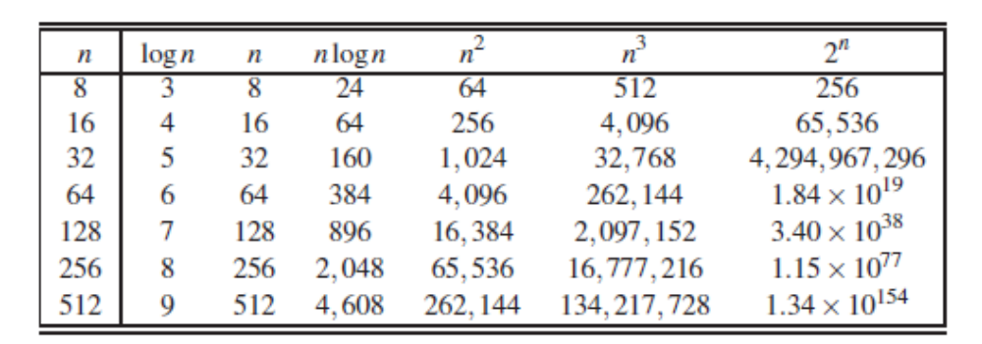
Why is Asymptotic Complexity So Important?
Asymptotic complexity gives an idea of how rapidly the space/time requirements grow as problem size increases.

Slide 12
How do we compare algorithms?
Express running time as a function of the input size n (i.e., f(n)).
Compare different functions corresponding to running times.
Such an analysis is independent of machine time, programming style, etc.

Slide 13
Rate of Growth
Consider the example of buying elephants and goldfish:
Cost: cost_of_elephants + cost_of_goldfish
Cost ~ cost_of_elephants (approximation)
The low order terms in a function are relatively insignificant for large n
n⁴ + 100n² + 10n + 50 ~ n⁴
i.e., we say that n⁴ + 100n² + 10n + 50 and n⁴ have the same rate of growth

Slide 14
Asymptotic Notation
O notation: asymptotic “less than”:
  f(n)=O(g(n)) implies: f(n) “≤” g(n)
Ω notation: asymptotic “greater than”:
  f(n)= Ω (g(n)) implies: f(n) “≥” g(n)
Θ notation: asymptotic “equality”:
  f(n)= Θ (g(n)) implies: f(n) “=” g(n)

Slide 15

O-notation
For function g(n), we define O(g(n)), big-O of n, as the set:
O(g(n)) = {f(n) :
∃ positive constants c and n_{0,} such that ∀n ≥ n₀,
we have 0 ≤ f(n) ≤ cg(n) }
Intuitively: Set of all functions whose rate of growth is the same as or lower than that of g(n).
g(n) is an asymptotic upper bound for f(n).

Slide 16

Ω -notation
For function g(n), we define Ω(g(n)), big-Omega of n, as the set:
Ω(g(n)) = {f(n) :
∃ positive constants c and n_{0,} such that ∀n ≥ n₀,
we have 0 ≤ cg(n) ≤ f(n)}
Intuitively: Set of all functions whose rate of growth is the same as or higher than that of g(n).
g(n) is an asymptotic lower bound for f(n).

Slide 17

Θ-notation
For function g(n), we define Θ(g(n)), big-Theta of n, as the set:
Θ(g(n)) = {f(n) :
∃ positive constants c₁, c₂, and n_{0,} such that ∀n ≥ n₀,
we have 0 ≤ c₁g(n) ≤ f(n) ≤ c₂g(n)
}
Intuitively: Set of all functions that
have the same rate of growth as g(n).
g(n) is an asymptotically tight bound for f(n).

Slide 18
Using the Definition of Big-O Notation
Example: Show that 7x² is O(x³).
Solution: When x > 7, 7x² < x³. Take C =1 and k = 7 as witnesses to establish that 7x² is O(x³).

Slide 19
Big-O Estimates for some Important Functions
Example: Use big-O notation to estimate the sum of the first n positive integers.
Solution:

Slide 20
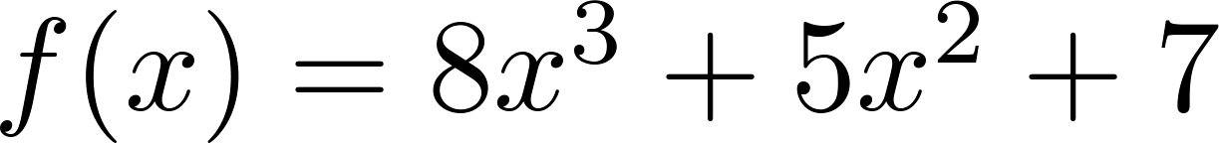
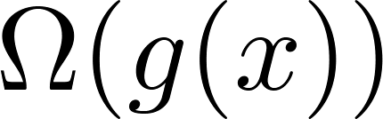
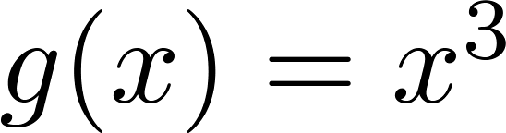
Big-Omega Notation
Example: Show that is
where .
Solution: for all positive real numbers x.

Slide 21
Big-Theta Notation
Example: Show that f(x) = 3x² + 8x log x is Θ(x²).
Solution:
    3x² + 8x log x ≤ 11x² for x > 1, since 0 ≤ 8x log x ≤ 8x² .
      Hence, 3x² + 8x log x is O(x²).
    x² is clearly O(3x² + 8x log x)
    Hence, 3x² + 8x log x is Θ(x²).
    So c1= 1 and c2=11 and K=1

Slide 22
Big-O and Growth Rate
The big-Oh notation gives an upper bound on the growth rate of a function
The statement “f(n) is O(g(n))” means that the growth rate of f(n) is no more than the growth rate of g(n)
We can use the big-Oh notation to rank functions according to their growth rate

Slide 23
Big-O Rules
If is f(n) a polynomial of degree d, then f(n) is O(n^{d}), i.e.,
  Drop lower-order terms
  Drop constant factors
Use the smallest possible class of functions
  Say “2n is O(n)” instead of “2n is O(n²)”
Use the simplest expression of the class
  Say “3n + 5 is O(n)” instead of “3n + 5 is O(3n)”

Slide 24
Asymptotic Algorithm Analysis
The asymptotic analysis of an algorithm determines the running time in big-Oh notation
To perform the asymptotic analysis
  We find the worst-case number of primitive operations executed as a function of the input size
  We express this function with big-Oh notation
Since constant factors and lower-order terms are eventually dropped anyhow, we can disregard them when counting primitive operations

Slide 25

Computing Prefix Averages
We further illustrate asymptotic analysis with two algorithms for prefix averages
The i-th prefix average of an array X is average of the first (i + 1) elements of X:
A[i] = (X[0] + X[1] + … + X[i])/(i+1)
Computing the array A of prefix averages of another array X has applications to financial analysis

Slide 26
Prefix Averages (Quadratic)
The following algorithm computes prefix averages in quadratic time by applying the definition
Algorithm prefixAverages1(X, n)
Input array X of n integers
Output array A of prefix averages of X #operations
A ← new array of n integers n
for i ← 0 to n − 1 do n
s ← X[0] n
for j ← 1 to i do 1 + 2 + …+ (n − 1)
s ← s + X[j] 1 + 2 + …+ (n − 1)
A[i] ← s / (i + 1) n
return A 1

Slide 27
Prefix Averages (Linear)
The following algorithm computes prefix averages in linear time by keeping a running sum
Algorithm prefixAverages2(X, n)
Input array X of n integers
Output array A of prefix averages of X #operations
A ← new array of n integers n
s ← 0 1
for i ← 0 to n − 1 do n
s ← s + X[i] n
A[i] ← s / (i + 1) n
return A 1

Slide 28
Remarks
For asymptotic running time, we do not need to count precise number of operations executed by each statement, provided that number of operations is independent of input size. Just use symbolic constants like c1, c2, … instead.
Our estimate used a precise count for the number of times the j loop was executed in selection sort (e.g., n*(n-1)/2). Could have said it was executed n² times and still have obtained the same big-O complexity.
Once you get the hang of this, you can quickly zero in on what is relevant for determining asymptotic complexity.

Slide 29
Analysis of Algorithm
What is the complexity of the following functions?
int a = 0, b = 0;
for (i = 0; i < N; i++) {
a = a + rand();
}
for (j = 0; j < M; j++) {
b = b + rand();
}
int a = 0, b = 0;
int a = 0;
for (i = 0; i < N; i++) {
for (j = N; j > i; j--) {
a = a + i + j;
}
} }

Slide 30
int a = 0, b = 0;
int i, j, k = 0;
for (i = n / 2; i <= n; i++) {
for (j = 2; j <= n; j = j * 2) {
k = k + n / 2;
}
} }
int a = 0, i = N;
while (i > 0) {
a += i;
i /= 2;
}

